Slide 1
Chapter 10 Thinking in Objects

Slide 2
UML Diagram

Slide 3
Class Abstraction and Encapsulation
Class abstraction
Separate class implementation from the use of the class.
User of the class does not need to know how the class is implemented.
Detail of implementation is encapsulated and hidden from the user.

Slide 4
Discovering Classes
A class
represents a single concept
Name should be a noun describing concept
Point
Rectangle
Ellipse
BankAccount CashRegister

Slide 5
Discovering Classes
Actors – objects do some kinds of work for you:
Scanner Random // better name: RandomNumberGenerator
Utility classes – no objects, only static methods and constants:
Math
Program starter classes:
only have a main method
Don’t turn actions into classes
Paycheck is a better name than ComputePaycheck

Slide 6
Cohesion
A class should represent a single concept
The public interface of a class is cohesive if all of its features are related to the concept that the class represents
This class lacks cohesion:
public class CashRegister { public void enterPayment(int dollars, int quarters, int dimes, int nickels, int pennies) ... public static final double NICKEL_VALUE = 0.05; public static final double DIME_VALUE = 0.1; public static final double QUARTER_VALUE = 0.25; ... }

Slide 7
Cohesion
CashRegister, as described above, involves two concepts: cash register and coin
Solution: Make two classes:
public class Coin { public Coin(double aValue, String aName) { ... } public double getValue() { ... } ... } public class CashRegister { public void enterPayment(int coinCount, Coin coinType) { ... } ... }

Slide 8
Coupling
A class depends on another if it uses objects of that class
CashRegister depends on Coin to determine the value of the payment
Coin does not depend on CashRegister
High coupling = Many class dependencies
Minimize coupling to minimize the impact of interface changes
To visualize relationships draw class diagrams
UML: Unified Modeling Language
Notation for object-oriented analysis and design

Slide 9
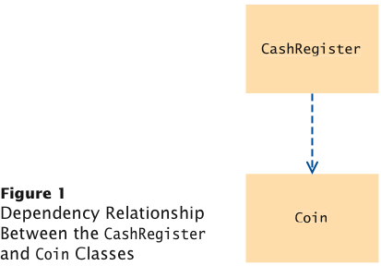
Dependency

Slide 10
Static Methods
Every method must be in a class
A static method is not invoked on an object
Why write a method that does not operate on an object
Common reason: encapsulate some computation that involves only numbers.
Numbers aren’t objects, you can’t invoke methods on them. E.g. x.sqrt() can never be legal in Java

Slide 11
Static Variables
A static variable belongs to the class, not to any object of the class:
public class BankAccount { ... private double balance; private int accountNumber; private static int lastAssignedNumber = 1000; }
If lastAssignedNumber was not static, each instance of BankAccount would have its own value of lastAssignedNumber

Slide 12
Static Variables
Three ways to initialize:
Do nothing. variable is initialized with 0 (for numbers), false (for boolean values), or null (for objects)
Use an explicit initializer, such as
public class BankAccount { ... private static int lastAssignedNumber = 1000; // Executed once, }
Use a static initialization block
Static variables should always be declared as private

Slide 13
Static Variables
Exception: Static constants, which may be either private or public:
public class BankAccount { ... public static final double OVERDRAFT_FEE = 5;
// Refer to it as BankAccount.OVERDRAFT_FEE }
Minimize the use of static variables (static final variables are ok)

Slide 14
Scope of Local Variables
Scope of variable: Region of program in which the variable can be accessed
Scope of a local variable extends from its declaration to end of the block that encloses it

Slide 15
Scope of Local Variables
Sometimes the same variable name is used in two methods:
public class RectangleTester { public static double area(Rectangle rect) { double r = rect.getWidth() * rect.getHeight(); return r; } public static void main(String[] args) { Rectangle r = new Rectangle(5, 10, 20, 30); double a = area(r); System.out.println(r); } }
These variables are independent from each other; their scopes are disjoint

Slide 16
Scope of Local Variables
Scope of a local variable cannot contain the definition of another variable with the same name:
Rectangle r = new Rectangle(5, 10, 20, 30); if (x >= 0) { double r = Math.sqrt(x); // Error - can't declare another variable
// called r here ... }

Slide 17
Overlapping Scope
A local variable can shadow a variable with the same name
Local scope wins over class scope:
public class Coin { private String name; private double value; // variable with same name
public double getExchangeValue(double exchangeRate) { double value; // Local variable ... return value; } }

Slide 18
Overlapping Scope
Access shadowed variables by qualifying them with the this reference:
value = this.value * exchangeRate;

Slide 19
Organizing Related Classes into Packages
To put classes in a package, you must place a line
package packageName;
as the first instruction in the source file containing the classes
Package name consists of one or more identifiers separated by periods

Slide 20
Importing Packages
Can always use class without importing:
java.util.Scanner in = new java.util.Scanner(System.in);
Tedious to use fully qualified name
Import lets you use shorter class name:
import java.util.Scanner;
...
Scanner in = new Scanner(System.in)
Can import all classes in a package:
import java.util.*;
Never need to import java.lang
You don’t need to import other classes in the same package

Slide 21
Package Names
Use packages to avoid name clashes
java.util.Timer
vs.
javax.swing.Timer
Package names should be unambiguous
Recommendation: start with reversed domain name:
com.horstmann.bigjava
edu.sjsu.cs.walters: for Britney Walters’ classes (walters@cs.sjsu.edu)
Path name should match package name:
com/horstmann/bigjava/Financial.java

Slide 22
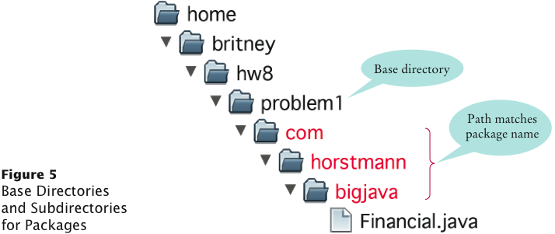
Package and Source Files
Base directory: holds your program's Files
Path name, relative to base directory, must match package name:
com/horstmann/bigjava/Financial.java

Slide 23
Aggregation
Has A relationship
Represents an ownership relationship between two objects
Owner object
Aggregating object
Aggregating class.
Subject object
Aggregated object
Aggregated class.

Slide 24

Object Composition
Composition is actually a special case of the aggregation relationship.
Care that you get the same object
Strong relation between objects

Slide 25
Class Representation
An aggregation relationship is can be represented as a data field in the aggregating class.

Slide 26
Example: The Course Class

Slide 27
Aggregation or Composition
Aggregation
“Weaker”
Don’t care that you get the exact object, just one of that type
Composition
“Stronger” relationship
Want the same object when being used

Slide 28
Aggregation Between Same Class
Aggregation may exist between objects of the same class. For example, a person may have a supervisor.
public class Person {
// The type for the data is the class itself
private Person supervisor;
...
}

Slide 29
Aggregation Between Same Class
What happens if a person has several supervisors?

Slide 30
Wrapper Classes
Boolean
Character
Short
Byte
Integer
Long
Float
Double
NOTE: (1) The wrapper classes do not have no-arg constructors. (2) The instances of all wrapper classes are immutable, i.e., their internal values cannot be changed once the objects are created.
30

Slide 31
The Integer and Double Classes
31

Slide 32
The Integer Class and the Double Class
Constructors
Class Constants MAX_VALUE, MIN_VALUE
Conversion Methods
32

Slide 33
Numeric Wrapper Class Constructors
You can construct a wrapper object either from a primitive data type value or from a string representing the numeric value. The constructors for Integer and Double are:
public Integer(int value)
public Integer(String s)
public Double(double value)
public Double(String s)
33

Slide 34
Numeric Wrapper Class Constants
MAX_VALUE represents the maximum value of the corresponding primitive data type.
For Byte, Short, Integer, and Long, MIN_VALUE represents the minimum byte, short, int, and long values.
For Float and Double, MIN_VALUE represents the minimum positive float and double values.
34

Slide 35
Conversion Methods
Each numeric wrapper class implements the abstract methods doubleValue, floatValue, intValue, longValue, and shortValue, which are defined in the Number class. These methods “convert” objects into primitive type values.
35

Slide 36
The Static valueOf Methods
The numeric wrapper classes have a useful class method, valueOf(String s). This method creates a new object initialized to the value represented by the specified string. For example:
Double doubleObject = Double.valueOf("12.4");
Integer integerObject = Integer.valueOf("12");
36

Slide 37
The Methods for Parsing Strings into Numbers
You have used the parseInt method in the Integer class to parse a numeric string into an int value and the parseDouble method in the Double class to parse a numeric string into a double value. Each numeric wrapper class has two overloaded parsing methods to parse a numeric string into an appropriate numeric value.
37

Slide 38
Automatic Conversion Between Primitive Types and Wrapper Class Types
JDK 1.5 and up allows primitive type and wrapper classes to be converted automatically. For example, the following statement in (a) can be simplified as in (b):
Integer[] intArray = {1, 2, 3};
System.out.println(intArray[0] + intArray[1] + intArray[2]);
Unboxing
38

Slide 39
StringBuilder and StringBuffer
The StringBuilder/StringBuffer class is an alternative to the String class. In general, a StringBuilder/StringBuffer can be used wherever a string is used. StringBuilder/StringBuffer is more flexible than String. You can add, insert, or append new contents into a string buffer, whereas the value of a String object is fixed once the string is created.

Slide 40
StringBuilder Constructors

Slide 41
Modifying Strings in the Builder

Slide 42
The toString, capacity, length, setLength, and charAt Methods

Slide 43
Problem: Checking Palindromes
Create a program that checks to see if a set of characters is a Palindrome.
A Palindrome is a String that is the same forward and backward

Slide 44
Regular Expressions
Appendix H
A regular expression (abbreviated regex) is a string that describes a pattern for matching a set of strings. Regular expression is a powerful tool for string manipulations. You can use regular expressions for matching, replacing, and splitting strings.

Slide 45
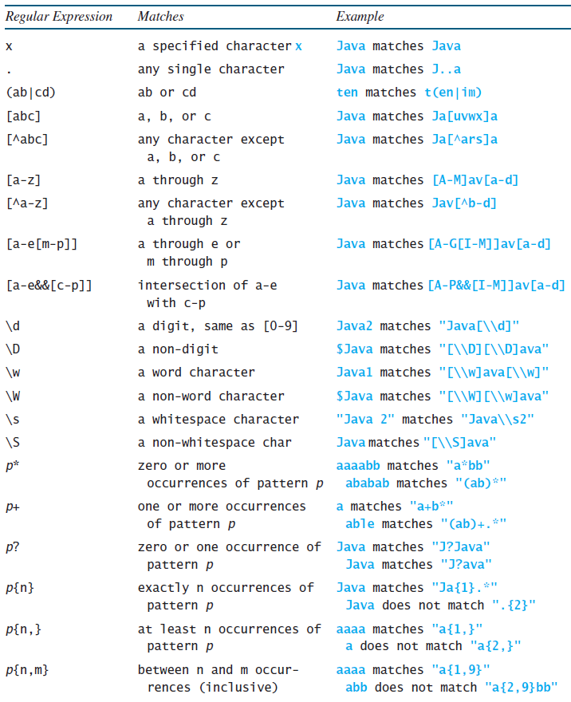
Regular Expression Syntax
Appendix H

